Slide 1
Snake Species Detection
UE20CS302 – Machine Intelligence
Course Final Project
Project Guide: Dr. Pooja Agarwal
TEAM 12
SRN | NAME
PES2UG20CS038 | AMISHA MATHEW
PES2UG20CS057 | ANURAG G
PES2UG20CS060 | ANUSHKA GUPTA

Slide 2
Problem Statement
Keeping in mind the increased number of deaths of humans due to snake bites as well as killing of snakes without having the knowledge if the snake is venomous or not has caused a major concerns for the humans and the snake species.
Therefore our team has decided to come up with a predictive model to showcase that not all snakes are dangerous and also to bring awareness about the kind of antivenom required for the same if bitten.
This presentation is to showcase a Predictive Model developed to predict if the snake is venomous or non venomous.
Notes:
Provide a basic introduction of the project and also an overview of scope it entails.
Set the context.

Slide 3
Application and Uses
Once developed into an app, can be used to provide the immediate first-aid to the poisoned
Can be used for research purposes around snakes
To widen the use-case spectrum of the poison present in snakes
Used in hospitals when the Clinical toxicologists is not available
Notes:
Provide a basic introduction of the project and also an overview of scope it entails.
Set the context.

Slide 4
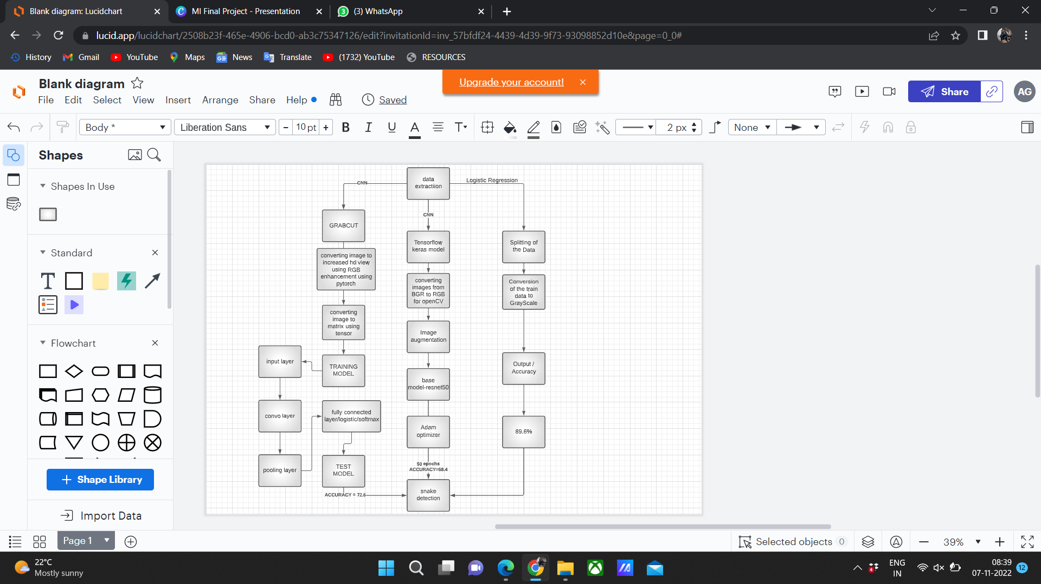
High level Architecture
Notes:
Provide a basic introduction of the project and also an overview of scope it entails.
Set the context.

Slide 5
Literature Survey
Title of the paper | Year of Publication | Journal/Conference Name | Advantages | Limitations
Snake Species Identification and Recognition | 2020 | IEEE IEEE Bombay Section Signature Conference (IBSSC) | Grabcut algorithm implementation densenet161 | Accuracy is not upto the mark
A Survey on Snake Species Identification using Image Processing Technique | 2018 | International Journal of Computer Applications | YOLO algorithm to convert the n*n matrix to smaller matrix | works only for video inputs and not images
Snake Species Recognition using Tensor Flow Machine Learning Algorithm & Effective Convey System | 2019 | International Conference on Communication and Information Processing (ICCIP2019) | expansion layer Depthwise cnn-contains 1*1 convolution and mobilenet-v2 projection layer | no explanation of other cnn layers used
Notes:
Provide summary of Phase – 1.
Include the suggestions and improvements made.

Slide 6
Literature Survey
Title of the paper | Year of Publication | Journal/Conference Name | Advantages | Limitations
Smart Snake Identification using Video Processing | 2021 | IEEE Region 10 International Conference TENCON | Offline and online real time identification using YOLO | No big dataset available for video processing
Snake Species Identification by using natural language processing | 2019 | Indonesian Journal of Electrical Engineering and Computer Science | ML algorithms used- naive bayes, KNN, SVM and decision trees | Dataset has to be in the form of unstructured text
Combination of image and location information for snake species identification using object detection and EfficientNets | 2020 | Conference and Labs of the Evaluation Forum(CLEF) | Mask R-CNN for object detection and EfficientNets for classification | None, an adoption of this method was used in one of the algorithms
Notes:
Provide summary of Phase – 1.
Include the suggestions and improvements made.

Slide 7
Literature Survey
Title of the paper | Year of Publication | Journal/Conference Name | Advantages | Limitations
A CNN Based Model for Venomous and Non-venomous Snake Classification | Jul 26, 2021 | International Conference on Applied Intelligence and Informatics, UK | Inception Net, VGG 19, Resnet50, Xception Net,. MobileNet v2, Inception Resnet V2 and VGG 16 were used | perform a grid hunt on the hyper-parameter for and find the most suitable number of parameter values for K fold cross validation would be beneficial
Automatic Snake Classification using Deep Learning Algorithm | September 2021 | CLEF 2021 – Conference and Labs of the Evaluation Forum | Newer DL Arch. ResNeXt50-V2. | No enough datapoint covering the vast classification of snakes
Herpetofauna Species Classification from Images with Deep Neural Network | 11 November 2020 | IEEE 2020 Intermountain Engineering, Technology and Computing (IETC) | CONV layers varied from 2 to 5 layers having 23 to 128 nodes activated with the ReLU function | Difficulty dealing with highly imbalanced data.
Notes:
Provide summary of Phase – 1.
Include the suggestions and improvements made.

Slide 8
Thank You

